Slide 1

The Beckmen Project
Ben Simondet, Emilee Nyberg, Courtney Clark, Katie Mahoney, Michael Nyman, Ethan Westering, Nick Berman
Notes:
KATIE

Slide 2

Project Roles
Emilee- Project Manager
Katie- Project Controller
Ethan- Developer
Ben- Developer
Nick- Quality Assurance Tester
Courtney- Requirements Analyst
Michael- Requirements Analyst
Notes:
KATIE “Next we’re going to have Ethan talk about the inspiration for his project”

Slide 3

Background
Ethan’s early exposure to technology opened eyes to a possible education and career in the technology field
Developing an interest early will allows them to plan accordingly and follow up in high school with classes/clubs
Notes:
ETHAN: Iowa State students came into his high school and developed on “Play My Code” website, showing students how to get started and assisted students with any questions. He described to the Beckman team that without this opportunity he may not have known this field was an option. His story and experience is what drove the team to decide to focus on an application where middle schoolers had an opportunity to be introduced to the technology field.

Slide 4

Code Arcade
Partner with schools
Stand out in industry
Security
Leader Board
Reward System
20 new computers to top school once an academic year
1 laptop to top individual once an academic year
Pizza party to top school
Early Introduction
Additional Resources
Notes:
MICHAEL

Slide 5
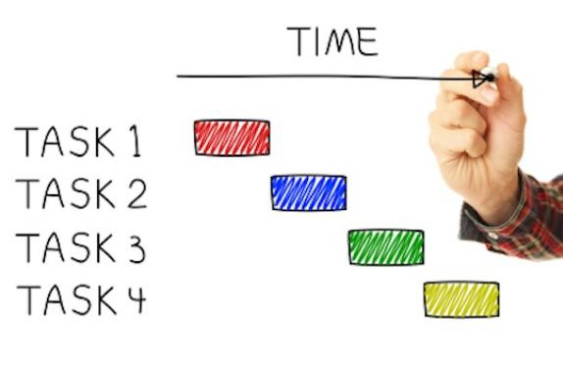
Project Plan
Project Start/End Date: June 14, June 17
Deliverables
User
Cindy
Notes:
EMILEE
User: Website that allows participating middle schools to access interactive coding website to introduce students to new technology
Cindy:
Status reports
Project Plan
PowerPoint
User Process Map
UAT
Epics
Requirements
Test Cases/Plan
Risks, Issues, Assumptions & Later Phases Report

Slide 6

Project Plan Continued
Timelines/Deadlines
Tuesday
Initial Design→ Website→ Process map→ Requirements
Wednesday
Game design→ Website live→ Testing
Thursday
Requirements→ Testing→ PowerPoint→ Practice
Constraints
Time to build multiple games
Resources to outsource email verification code and prizes for top school/individual
Risks
Security breach
Notes:
EMILEE Tuesday:
Facilitate discussion about initial ideas
Create domain and build web page design
Complete process map
Requirements for website Wednesday
Design game
All web pages go live
Begin testing
Thursday
Complete game requirements
Complete PowerPoint
Testing
Practice presentation

Slide 7

Epics
Student: As a middle school student interested in a future in technology, I want a log in that allows me to practice basic programming skills so that I can gain exposure to code before pursuing a degree in technology.
The Beckmen Project: As the technology and business developers of Code Arcade, we want the middle school age group to gain basic computer programming knowledge at an early age so that they can be informed when making future education and career decisions.
Notes:
EMILEE

Slide 8
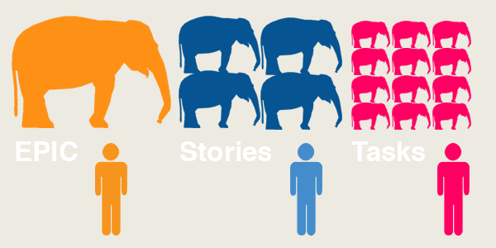
Epics Continued
School: As a participating school in Code Arcade, we want a program that gives our students exposure to technology at an earlier age so that they can explore their interests in computer sciences.
School: As a participating school in Code Arcade, we want our students to excel in the game so that we have the chance to receive 20 new computers to increase our technology resources to advance our classroom experience.
Notes:
EMILEE

Slide 9

Assumptions
User has valid email
User has access to a computer
User comprehends English
Phase 1: User attends one of the following partnered schools
Notes:
ETHAN

Slide 10
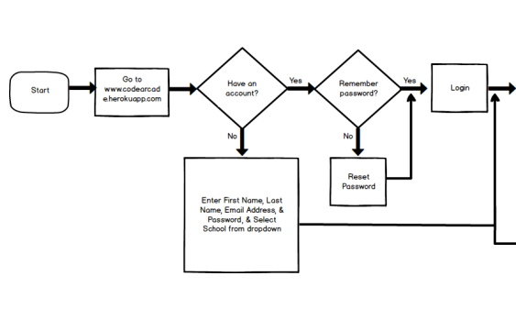
Process Map
Notes:
MICHAEL

Slide 11
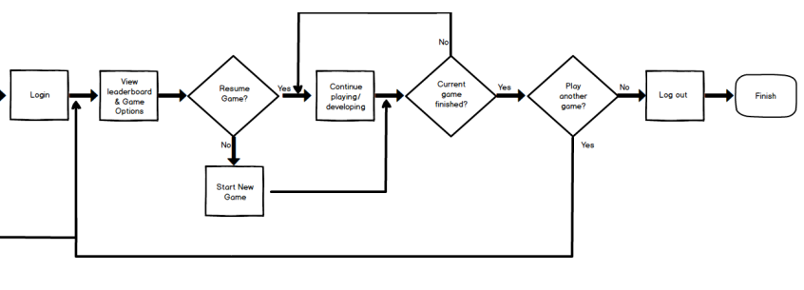
Process Map Continued
Notes:
MICHAEL

Slide 12
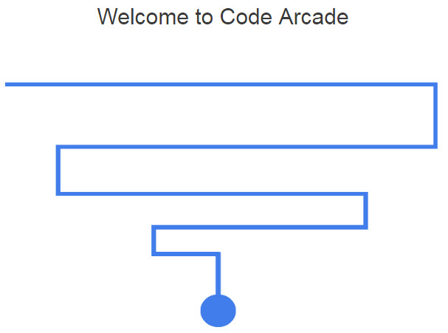
Website Link!
http://codearcade.herokuapp.com/
Notes:
BEN

Slide 13
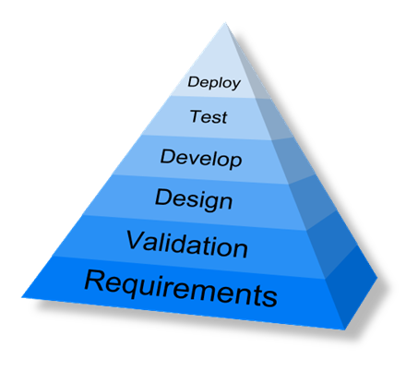
Requirements
Notes:
COURTNEY

Slide 14

Testing
Notes:
NICK

Slide 15

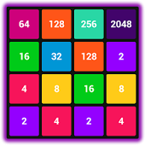

Phase II of Code Arcade
More games
Flappy Bird
2048
Chain Reaction
Reset Password Capability
Outsource to email service that will send emails with verification codes
Partner with more schools
Open access for more individuals
Chain Reaction
Notes:
BEN
Flappy Bird: (Ex: Gravity, game features, velocity, size of screen, colors) Potential Difficulty level: Hard
2048: (Ex: Styles, shapes, grids) Potential Difficulty level: medium
Chain Reaction: (Ex: Speed of bubbles, size of click circle, speed/direction of circles, # of bubbles, length of reaction time) Potential Difficulty level: medium

Slide 16

Questions

